Slide 1
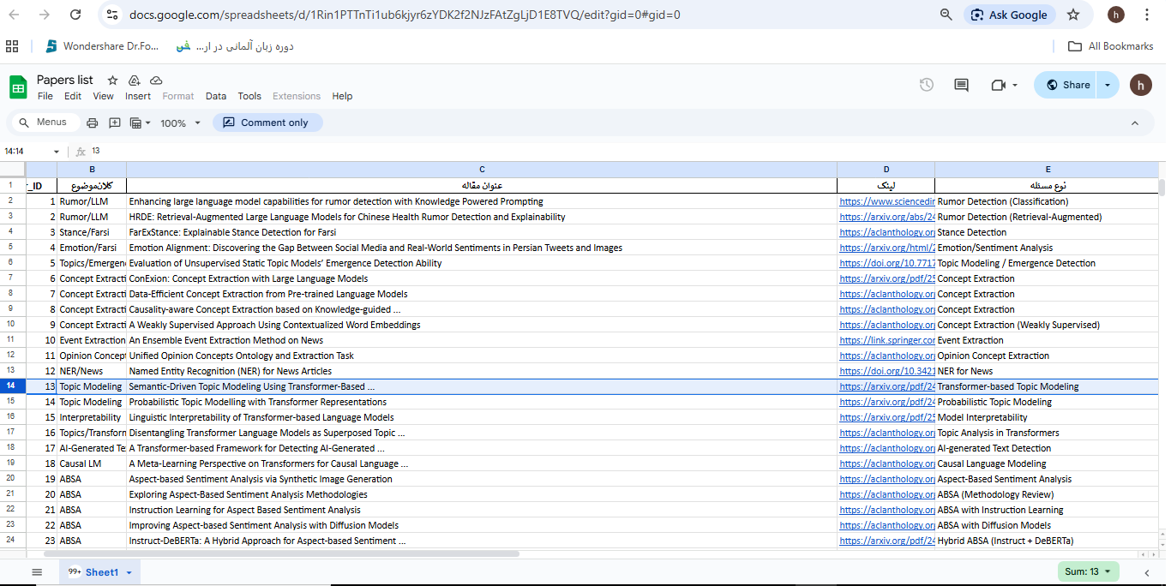
Transformer-based Topic Modeling

